Slide 1
INTRODUCTON OF AZURE
AZURE DATA FACTORY

Slide 2
What is Azure Data factory?
Introduction to Azure data factory service, a data integration service in the cloud.
Data factory is a cloud based data integration service that orchestrates and automate the movements the moment and transformations of data.
you can create data integration solutions usage the data Factory service that can be ingest data from various data sources, transformations/ process the data, and publish the results data to the stores.

Slide 3
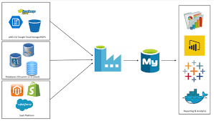
Why We Use ADF?
Enables enterprises:
To ingest data from multiple on premises and cloud sources easily, and gets your data where its need to go, prepare and partition your data as you inject it, or apply pre processing steps.
Allows you to create data pipelines :
That move and transform data , and then run the pipeline on a specified schedule(hourly, daily, weekly, etc..)
Provide Rich Visualization :
To Display the lineage, and dependendencies between your data pipelines from a single unified view.
Produce Trusted/accurate data:
It would be providing most useful and scalable and transformed data to get the instant results

Slide 4
What Can we use Data Factory for?
DATA ENRICHMENT
Use it to Ingest data from the multiple on premises and cloud sources.
Schedule, Orchestration, and manage the data transformation and analysis process.
Transform raw data into finished or shaped data that's ready for consumptions by BI tools or by your on premises or cloud application and services.
Manage your entire network of data pipelines at a glance to identify issues take action.
DATA INTEGRATION
DATA MITIGATION
DATA TRANSFORMATION
DATA CLEANING
DATA IOT ANALYSIS
DATA LOADING
DATA WAREHOUSING
DATA MODELING

Slide 5
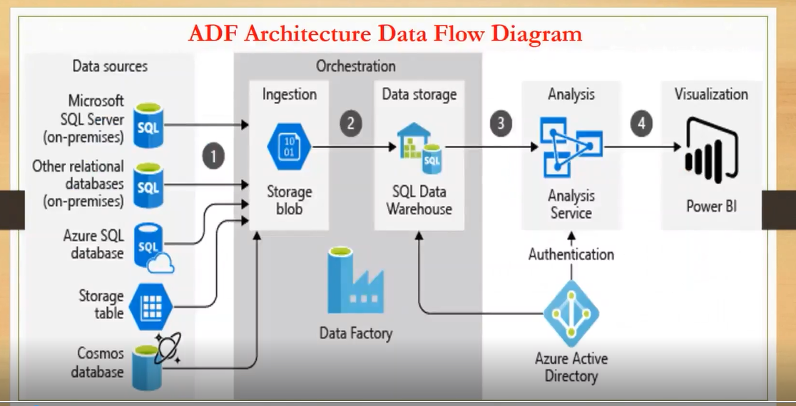
INGESTION
PREPARE
TRANSFORM
ANALYSE
PUBLISH

Slide 6
TYPES OF ACTIVITIES?
What is Activity :
Activities define the actions to perform on your data. for example, you may use a copy activity data from one data source to another data source .
Similarly, you may use a Stored Procedure activity, which runs a sql query to transform or
analyze your data. you may also choose to create a custom .NET activity to run your own code.
Data Movement Activity:
Copy activity in Data Factory copies data from a source data store to a sink data source.
data from any source can be written to any sink.
Data Transformation Activities :
Data Transformations Activities data to desired format and shape.
Transformation activities that can be added to added to pipelines either individually or chained with another activities.

Slide 7
Types of Services
Linked Services :
Lined services define the information needed for data factory to connect to external resources ( Examples: Azure Storage, On Premises SQL Server, Azure HDInsight).
Integration Runtime:
The integration runtime location defines the location of its back-end compute, and where the data movement,
activity dispatching and data transformation are performed. To obtain better performance and transmission efficiency,
the integration runtime should be closer to the data source or sink.
Auto Resolve Integration Runtime:
Azure Data Factory decides how much compute power is required within a selected data center.
Then it will perform data movement and processing operations using the available compute power
within the selected IR location. If you want to know how ADF decides which data center to be used for the IR

Slide 8
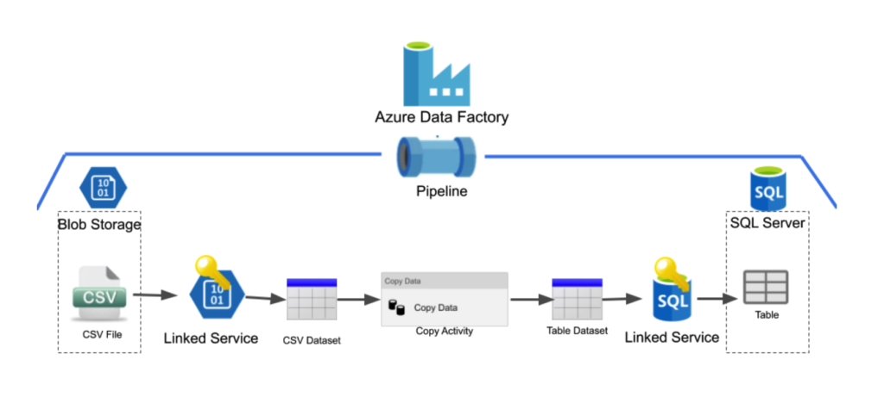

Slide 9
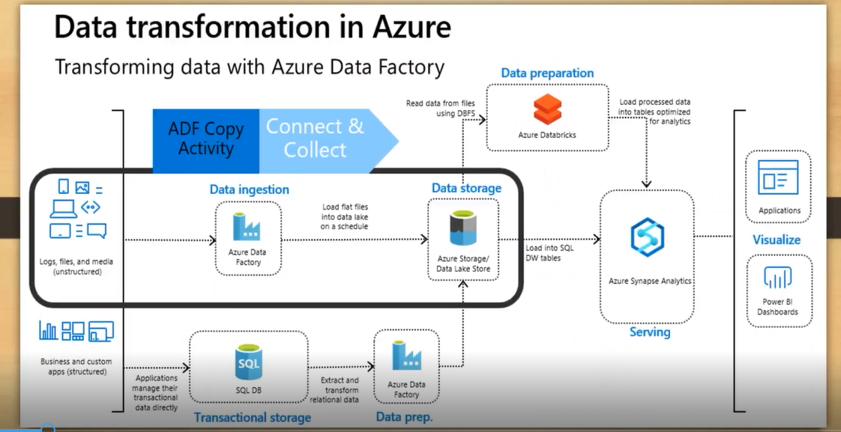
DATA TRANSFORMATIONS IN AZURE

Slide 10
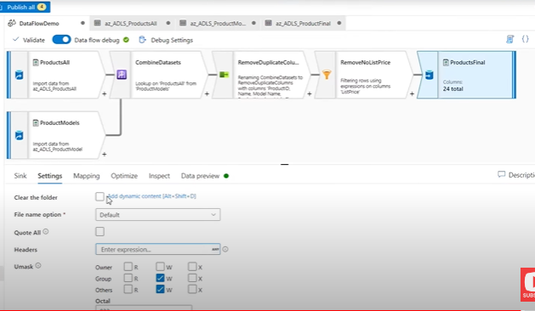

Data Transformation Activities :
Data Transformations Activities data to desired format and shape.
Transformation activities that can be added to added to pipelines either individually or chained with another activities.

Slide 11
ADVANTAGES ACTIVITIES AND USEFUL TRANSFORMATIONS
Creating Datasets: Linked services link data sources to an Azure data factory. Datasets represent data structures with in the data sources. For example, an Azure Storage linked service provides connections information for data factory to connect to an Azure Storage account. An Azure Blob Storage from which the pipeline should read the data.
Similarly, an Azure SQL lined service provide connection information for an Azure Sql Database and an Azure SQL Dataset specifies the tables that contains the data.
Web /HTTP URL Activity : Here we can extract huge amount of data from the web URLS.
Other Recourses: Here we can create and use other resources, such as creating Apps, App services, service bus, and event hubs for getting events data, logic apps for load messages.
Metadata & Lookup Activity : Using these activities, we can check the metadata properties .
Streaming and Incremental Data Load: Here we can perform some various types of activities to get the streaming and incremental data.
Derive Activity : By using this we can create new parameters based on certain conditions.
Conditional Activity : By using this we can spilt the data based on given scenarios.
Filter Activity : By using this we can filtering the data based on given conditions.
Insert Row Activity : By using this activity we can insert or update or delete the rows.
Joins and Lookups Activities : Using these activities we can merge the various datasets.
Pivot Activity : By using this activity we can do some pivotal summaries /tables based given conditions.
Sink Activity : Here we can use this activity to load the data into defined/desired location path.

Slide 12
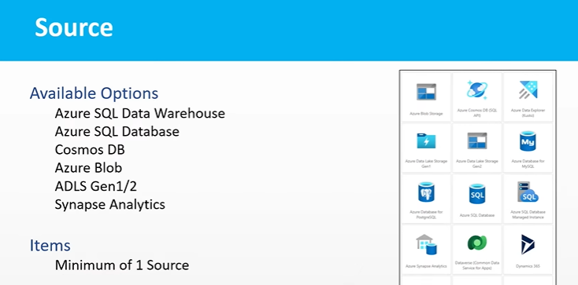

Slide 13
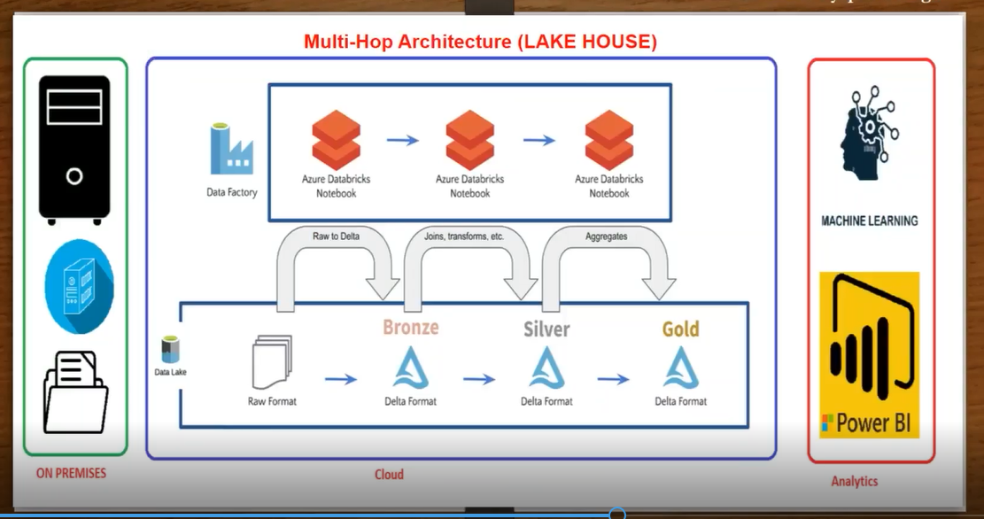

Slide 14
KEY POINTS TO BE ADDRESSED
First we need to have VPN Network
Make sure that secure private end points
Plan for migration to transform data to cloud environment
Identified master data sources, concentrated on data marts
Make sure that we have subscription, resource group, region and network .
Plan for staging data load and set up with the storage path
Creating a connection IR to connect to on-premises to cloud
Creating a Linked service to connect to data sources to adf and other sources.
Creating a pipeline and dataset to injecting data from various sources.
Perform copy data activity to get the data and then stored the data into location.
Perform dataflow mapping activities to transform the data and then load the data.
Creating triggers to run the pipeline activities on a daily basis
Creating feature branches pipelines and will do pull request to merge all pipelines in to master. Move the code into further development , staging, testing and production. And release the pipelines and maintain CI/CD pipelines.
Load the data into Synapse sql data warehouse to build data warehouse.
Creating Bronze, Silver and Gold layers for generating BI reports.
Connecting Gold layers to making reports and dashboards in Power BI
Connecting Bronze or Silver layers to perform statistical analysis and build ML and AI and predictive models.

Slide 15
THANK YOU
SANTHOSH BATHINI

